Slide 1

CMR COLLEGE OF ENGINEERING & TECHNOLOGY
(UGC Autonomous)
(NAAC Accredited with ‘A+’ Grade & NBA Accredited) (Approved by AICTE, Permanently Affiliated to JNTU Hyderabad)
KANDLAKOYA, MEDCHAL ROAD, HYDERABAD - 501401
Department of Electronics And Communication Engineering
A Minor project on
RTL BASED USB PACKET GENERATOR FOR REAL TIME DATA STREAMING
BATCH NO: 13
TEAM DETAILS:
GURRAM GAYATHRI
KAKINADA LASYA PRIYA EALETI VAMSHI KRISHNA NALLA ABHILASH
NIKHITHA GUDIVADA
(22H51A0484)
(22H51A0432)
(22H51A0479)
(22H51A04Q1)
(22H51A04H4)
Under the esteemed guidance of:
Mrs. M. Sirin Kumari
Assistant professor
1

Slide 2
CONTENT
RTL BASED USB PACKET GENERATOR FOR REAL TIME DATA STREAMING
ABSTRACT
PROJECT OBJECTIVES
PROPOSED METHODOLOGY
BLOCK DIAGRAM
EXISTING SOLUTIONS
EXPLANATION OF PROJECT
ADVANTAGES &DISADVANTAGES
FUTURE SCOPE
CONCLUSION
REFERENCES
BATCH NO: DV13

Slide 3
ABSTRACT
RTL BASED USB PACKET GENERATOR FOR REAL TIME DATA STREAMING
This project focuses on the development of a Register Transfer Level (RTL)-based USB packet generator designed for real-time data streaming applications. The packet generator is implemented using Verilog HDL and adheres to the USB 2.0 protocol, supporting the generation of token, data, and handshake packets. Its primary objective is to simulate and test USB-based communication systems by providing a reliable source of protocol-compliant data traffic.
The design incorporates configurable features, including adjustable packet size, packet type selection, and transmission intervals. These parameters can be set dynamically through a simple register interface, allowing real-time control and adaptability during operation. The packet generator is optimized for continuous, high-throughput streaming and deterministic timing behavior, making it ideal for embedded system validation and hardware-in-the-loop testing environments.
BATCH NO: DV13

Slide 4
OBJECTIVES
RTL BASED USB PACKET GENERATOR FOR REAL TIME DATA STREAMING
To design a hardware-based USB packet generator using Verilog HDL at the Register Transfer Level (RTL) for real-time data transmission.
To support multiple USB packet types, including:
Token packets (IN, OUT, SOF)
Data packets (DATA0, DATA1)
Handshake packets (ACK, NAK, STALL)
3. To implement essential USB protocol features in RTL such as:
CRC5 and CRC16 generation for error detection.
Bit stuffing to maintain data integrity during transmission.
NRZI encoding for signal encoding on the USB data lines.
BATCH NO: DV13

Slide 5
PROPOSED METHOD
RTL BASED USB PACKET GENERATOR FOR REAL TIME DATA STREAMING
We used Verilog, a hardware design language, to build the USB packet generator. It helps describe exactly how each part of the system should work, just like writing code but for electronic circuits.
How It Works :
A special control method called a Finite State Machine (FSM) is used to manage everything.It acts like a traffic controller that tells the system what to do next while forming and sending USB packets.
Making the USB Packets:
Our design creates different types of packets used in USB communication:
Token packets like IN, OUT, and SOF (Start of Frame)
Data packets to carry information
Handshake packets to confirm successful data transfer
Error checking:
CRC5 for token packetsCRC16 for data packets
Getting the Data USB-Ready:
We use NRZI encoding to convert our data into signals that USB lines understand.We also add bit stuffing – this just means inserting extra bits occasionally to keep the signal clean and synchronized.
Data Output:
Once the packet is ready, it’s sent through the USB lines (usb_dp and usb_dm). We also include a special End-of-Packet (EOP) signal so the receiving side knows where the message stops.
BATCH NO: DV13

Slide 6
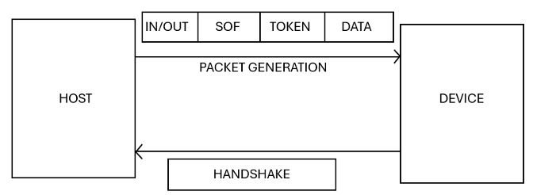
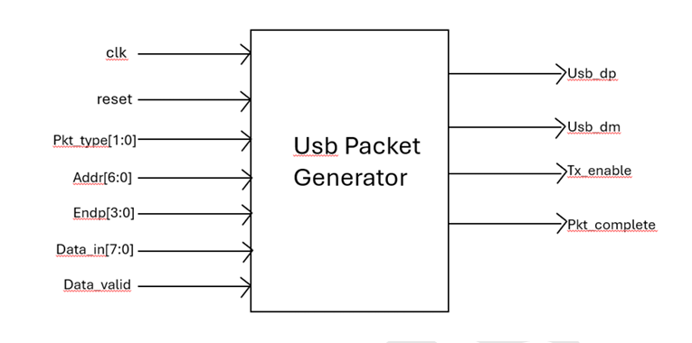
BLOCK DIAGRAM
RTL BASED USB PACKET GENERATOR FOR REAL TIME DATA STREAMING
USB PACKET GENERATOR
BATCH NO: DV13

Slide 7
EXISTING SOLUTIONS
RTL BASED USB PACKET GENERATOR FOR REAL TIME DATA STREAMING
Software-based USB Debugging Tools
FPGA-based USB Packet Generators
USB Traffic Generators / Emulators
The drawbacks of these existing solutions are proprietary, expensive, and limited to specific USB versions or features, restricting flexibility when compared to USB packet generator .
This project offers complete visibility, flexibility, low cost, and high educational value. It’s particularly suited for academic use, RTL learning, USB protocol research, and real-time simulation — unlike existing commercial solutions that are expensive, opaque, or too abstract.
BATCH NO: DV13

Slide 8
EXPLANATION
RTL BASED USB PACKET GENERATOR FOR REAL TIME DATA STREAMING
This project aims to design and implement a USB 2.0 packet generator using Register Transfer Level (RTL) design in Verilog HDL. It simulates and generates USB packets—Token, Data, and Handshake—for real-time data streaming and testing of USB-enabled embedded systems. The design is verified using simulations and also tested on FPGA hardware.
Generates and transmits USB packets such as OUT, IN, SOF, and DATA, following USB 2.0 protocol
TOKEN PACKETS : Used to communicate transaction type and target device.
Types:
OUT: Host → Device
IN: Device → Host
SOF: Start-of-Frame for timing synchronization
DATA PACKETS :Carry payload from host to device or vice versa.
BATCH NO: DV13

Slide 9
CONTD..
RTL BASED USB PACKET GENERATOR FOR REAL TIME DATA STREAMING
HANDSHAKE PACKETS : Acknowledge the status of the transaction.
Types:
ACK: Data received successfully o
NAK: Device not ready
STALL: Device encountered error
USB uses NRZI (Non-Return to Zero Inverted) encoding to transmit data over the differential usb_dp and usb_dm lines. In NRZI encoding, a logical '1' is represented by no change in the signal level, while a logical '0' is represented by a transition (inversion) on the differential pair.
CRC GENERATOR : Appends USB-compliant CRC fields for both token and data packets to ensure data integrity.
BATCH NO: DV13

Slide 10
RESULT
RTL BASED USB PACKET GENERATOR FOR REAL TIME DATA STREAMING
The system successfully generated all the required USB packet types — including token, data, and handshake packets — exactly as defined by the USB protocol. In the testbench, when the packet type is set to 0001 or 1011, it indicates an OUT packet, and the design assigns the PID value 0001 for this packet. The Token Address is formed by combining a 7-bit device address (example: 8) and a 4-bit endpoint number (example: 1), resulting in an 11-bit value, which equals 140 in decimal. The finite state machine (FSM) in the design starts in the idle state and transitions to the sync state, where it sends an 8-bit sync pattern using a bit counter. After completing the sync, it moves to the PID state and sends the 8-bit PID. When the bit count is less than 7, it transitions to the Token Address state and transmits the 11-bit Token Address. Then, a 5-bit CRC5 is added. The complete packet is NRZI encoded and transmitted through the USB DP and DM lines, which can be observed in the waveform.
BATCH NO: DV13

Slide 11
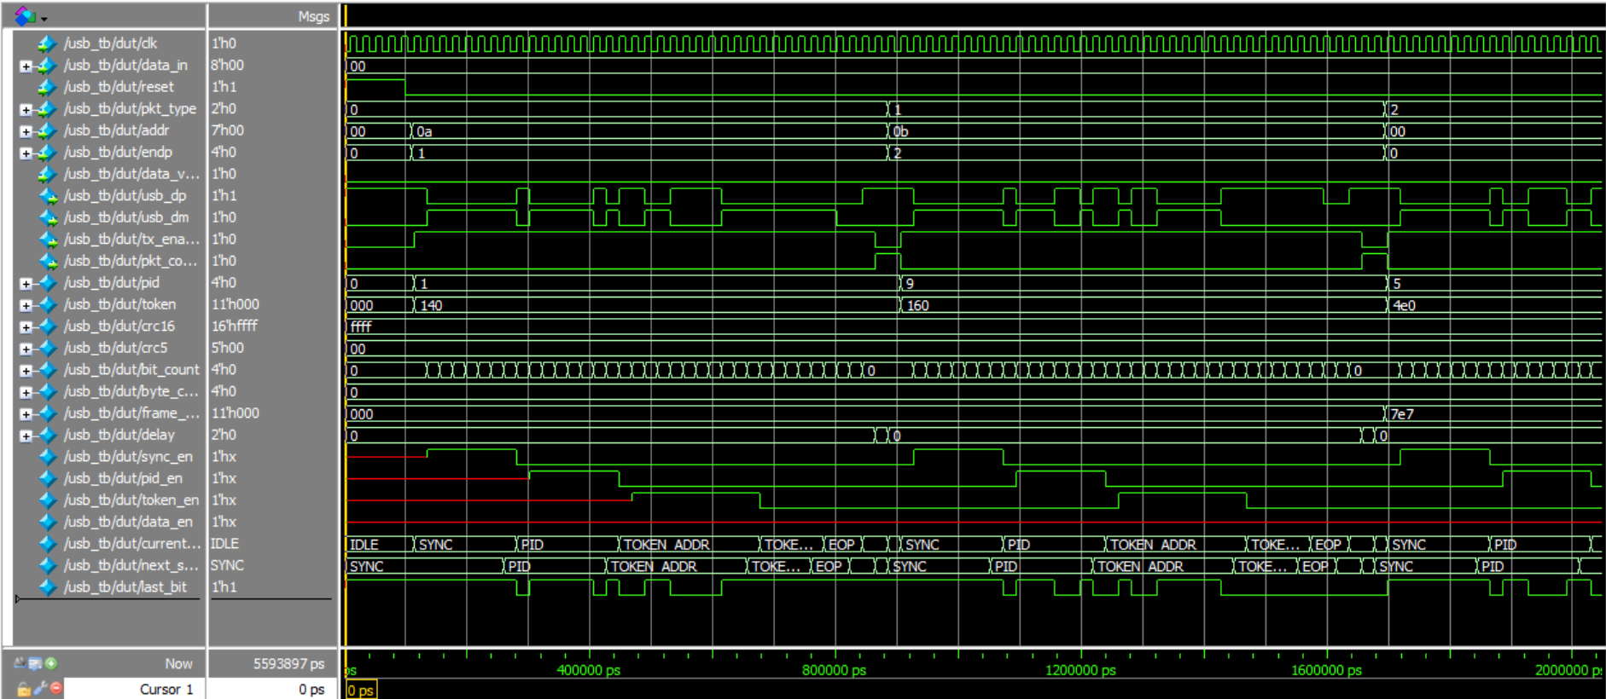
RESULT
RTL BASED USB PACKET GENERATOR FOR REAL TIME DATA STREAMING

Slide 12

ADVANTAGES
RTL BASED USB PACKET GENERATOR FOR REAL TIME DATA STREAMING
Real-Time Operation
Enables USB packet generation in real-time, suitable for hardware-in-the-loop testing and embedded systems.
Configurable Design
Allows dynamic control over packet type, payload size, and timing using a register interface—ideal for diverse test scenarios.
High Throughput & Low Latency
Achieves near maximum USB Full-Speed throughput (~11.5 Mbps) with minimal latency.
Industry-Relevant
USB communication is widely used in embedded systems, making this project industry-relevant.
Protocol Understanding
Helps you deeply understand packet structure (SYNC, PID, CRC, etc.)
BATCH NO: DV13
9
9

Slide 13
DISADVANTAGES
RTL BASED USB PACKET GENERATOR FOR REAL TIME DATA STREAMING
Complex Protocol
USB protocol has many layers and states, making full implementation challenging.
Limited Scope
Basic packet generation doesn’t cover full USB stack like enumeration, error handling, etc.
No Real Hardware Communication
Without a physical USB PHY layer, it can’t communicate with real USB hosts/devices.
Debug Difficulty
Signal-level issues are hard to trace without hardware debugging tools.
Speed Constraints
Simulated USB may not reflect real-world speed or timing accuracy.
10

Slide 14
CONCLUSION
RTL BASED USB PACKET GENERATOR FOR REAL TIME DATA STREAMING
In conclusion, this project successfully built a USB packet generator using Verilog at the RTL level, capable of handling real-time data transmission. It was able to create different types of USB packets—like token, data, and handshake packets—while fully following USB protocol standards. Essential features such as CRC error checking, bit stuffing, NRZI encoding, and FSM-based control were all integrated to make the system reliable and efficient. Simulation results confirmed that the design works as intended. Overall, this hardware-based solution offers both speed and accuracy, making it a great fit for real-time applications. It also lays a solid foundation for future improvements, such as adding support for USB 3.0, enhancing error detection, or integrating into more advanced systems.
BATCH NO: DV13

Slide 15
FUTURE SCOPE
RTL BASED USB PACKET GENERATOR FOR REAL TIME DATA STREAMING
The future of USB packet generators in real-time lies in increased speed, efficiency, and versatility, driven by advancements in USB standards like USB4 and the growing demand for faster data transfer in various applications.
Faster Data Transfer:USB4 and its future iterations, like Version 2.0, promise to deliver significantly faster data transfer rates, potentially doubling the current speeds to 80 Gbps. This will enable quicker file transfers, smoother video streaming, and more efficient data handling for demanding applications. Enhanced Debugging and Testing:USB packet generators will play a crucial role in debugging and testing USB interfaces, especially as they become more complex and high-speed. Integration with IoT and 5G:The increasing number of connected devices and the rise of 5G networks will require more efficient and robust USB communication. Packet generators will be essential for testing and verifying the connectivity and performance of devices in these environments.
BATCH NO: DV13

Slide 16
REFERENCES
RTL BASED USB PACKET GENERATOR FOR REAL TIME DATA STREAMING
USB Implementers Forum, Universal Serial Bus (USB) 2.0 Specification, Revision 2.0, April 2000. https://www.usb.org
Samir Palnitkar, Verilog HDL: A Guide to Digital Design and Synthesis, 2nd Edition, Pearson Education, 2003.
Jan Axelson, USB Complete: The Developer’s Guide, Fifth Edition, Lakeview Research, 2015.
Behrouz Forouzan, Data Communications and Networking, Fifth Edition, McGraw-Hill Education, 2013.
Douglas L. Perry, VHDL and Verilog Compared and Contrasted, Springer, 2002.
IEEE Standard 1364-2005, IEEE Standard for Verilog Hardware Description Language.
BATCH NO: DV13

Slide 17
RTL BASED USB PACKET GENERATOR FOR REAL TIME DATA STREAMING
THANK YOU

